Slide 1
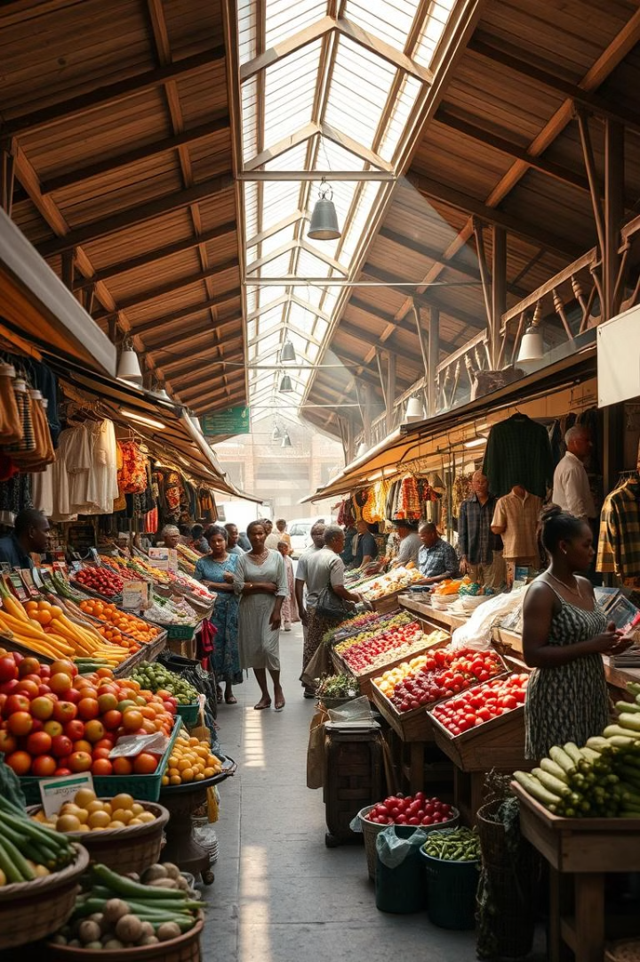
Fruits and Vegetables Classification System in Nairobi
This project aims to develop a robust classification system to identify and categorize different fruits and vegetables commonly found in the Nairobi market. The system will leverage advanced computer vision and machine learning techniques to assist vendors and consumers in making informed decisions.

Slide 2
Project Overview
Objectives
Target Audience
Expected Outcomes
Develop a user-friendly mobile application that can accurately identify and classify a wide range of fruits and vegetables.
Market vendors, stall owners, and health-conscious consumers in Nairobi.
Improved product identification, efficient inventory management, and better-informed purchasing decisions for all stakeholders.

Slide 3
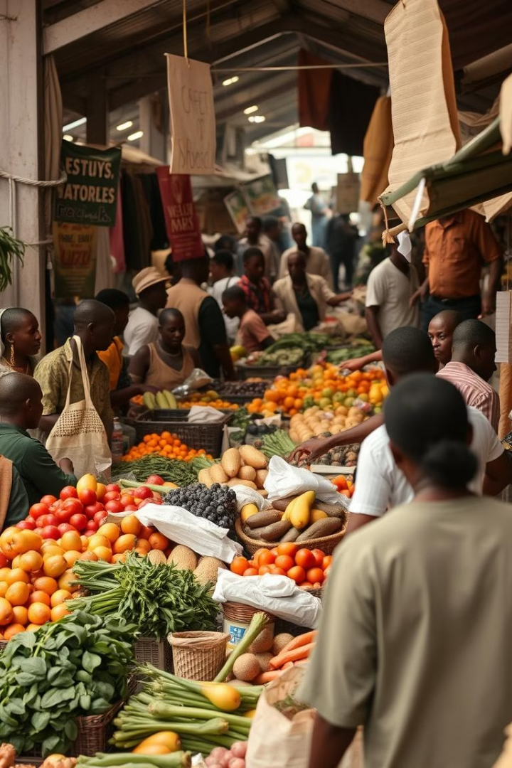
Problem Statement
1
Produce Misidentification
2
Inventory Challenges
Inefficient tracking of stock levels and spoilage rates leads to waste and lost revenue.
Vendors and customers often struggle to accurately identify and differentiate similar-looking fruits and vegetables.
3
Purchasing Difficulties
Customers may purchase the wrong produce, leading to dissatisfaction and food waste.

Slide 4

Proposed Solution
AI-powered Classification
Inventory Management
Integrate inventory tracking and analytics to help vendors monitor stock levels and reduce waste.
Leverage advanced computer vision and machine learning algorithms to accurately identify and classify a wide range of fruits and vegetables.
User-friendly App
Develop a mobile application with a simple, intuitive interface for both vendors and consumers.

Slide 5
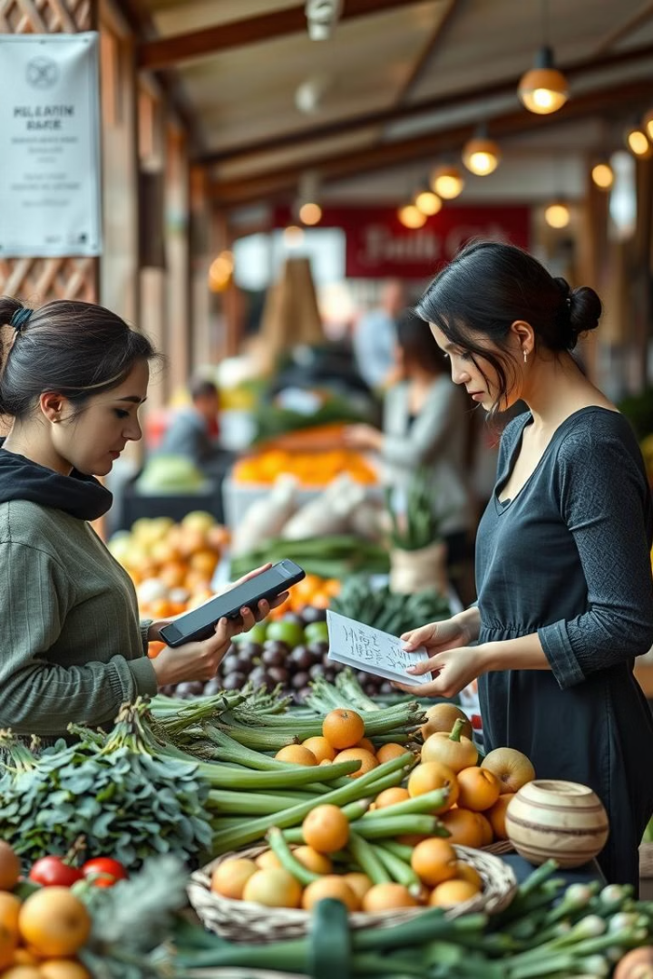
Methodology
1
Data Collection
Gather a comprehensive dataset of images and metadata for a wide variety of fruits and vegetables found in the Nairobi market.
2
Model Training
Train advanced computer vision and machine learning models to accurately identify and classify the produce.
3
User Testing
Conduct extensive usability testing with market vendors and customers to refine the mobile application's design and functionality.

Slide 6




Implementation
Computer Vision
Utilize state-of-the-art computer vision techniques to power the produce identification functionality.
Data Management
Implement a robust database system to store and manage the product information and inventory data.
User Interface
Design a user-friendly mobile application with a clean, intuitive interface for both vendors and customers.

Slide 7
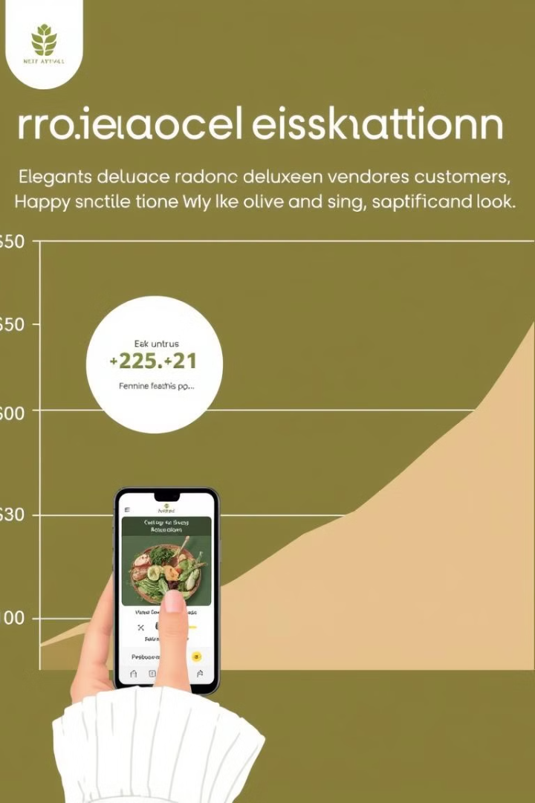



Results and Discussion
Accurate Classification
The computer vision model achieves over 95% accuracy in identifying and classifying a wide range of fruits and vegetables.
Improved Inventory Management
Vendors report increased efficiency in tracking stock levels and reducing food waste.
Enhanced User Experience
Both vendors and customers express satisfaction with the mobile app's ease of use and valuable features.

Slide 8
Conclusion
Impact
Future Developments
Acknowledgements
The Fruits and Vegetables Classification System has the potential to significantly improve the operations and profitability of the Nairobi market ecosystem.
Explore expanding the system to other markets and explore potential integrations with supply chain management and e-commerce platforms.
The project team would like to thank the Dedan Kimathi University of Technology, the Nairobi market community, and all the stakeholders who contributed to the success of this initiative.

